Slide 1
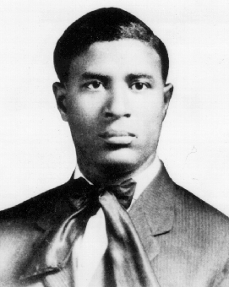
Garrett Morgan
Notes:
# Name Garrett Morgan # Textbook Knight, Physics for Scientists and Engineers: A Strategic Approach with Modern Physics, 3rd Edition, Chapter 15 Knight, Physics for Scientists and Engineers: A Strategic Approach with Modern Physics, 3rd Edition, Chapter 30 # Description Invented the smoke mask, which uses many mechanisms studied in physics like gas separation depending on density. He also used electricity to invent electric traffic signals in Cleveland. # Photo https://upload.wikimedia.org/wikipedia/en/f/f7/Garrett_Morgan.gif

